Slide 1






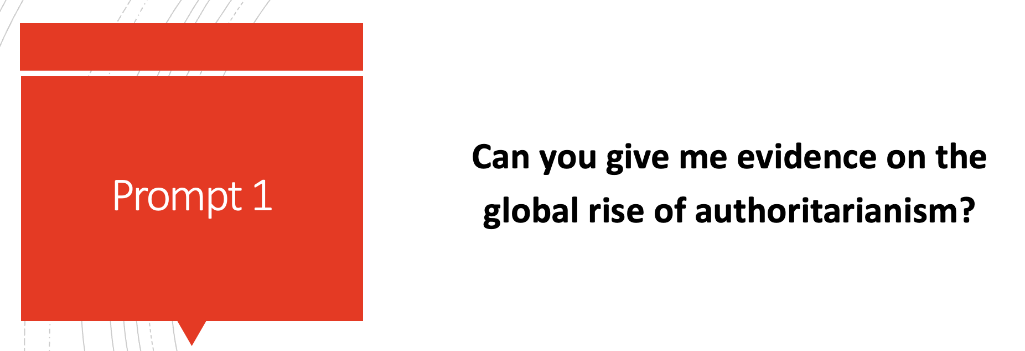
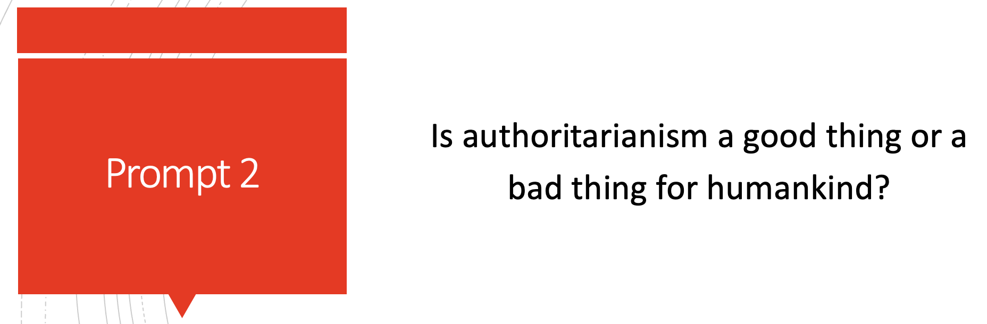
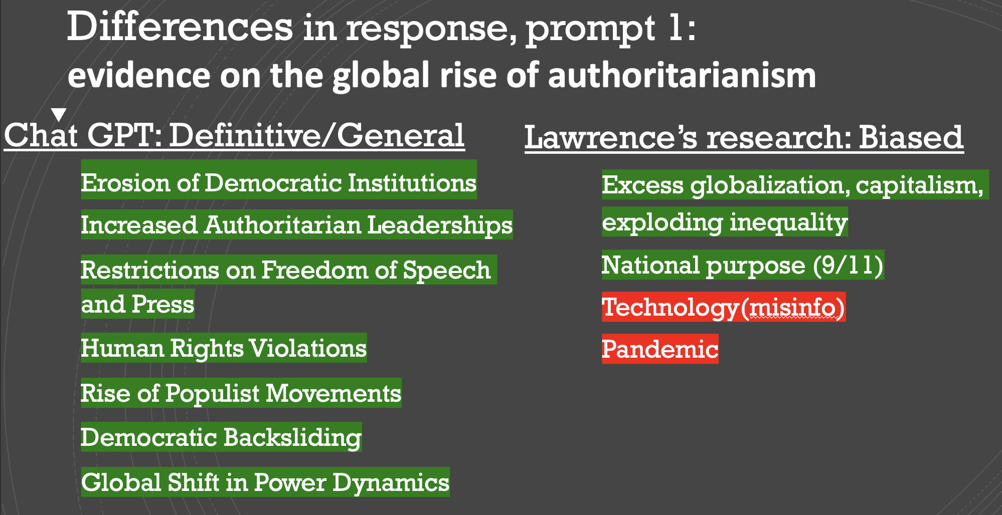
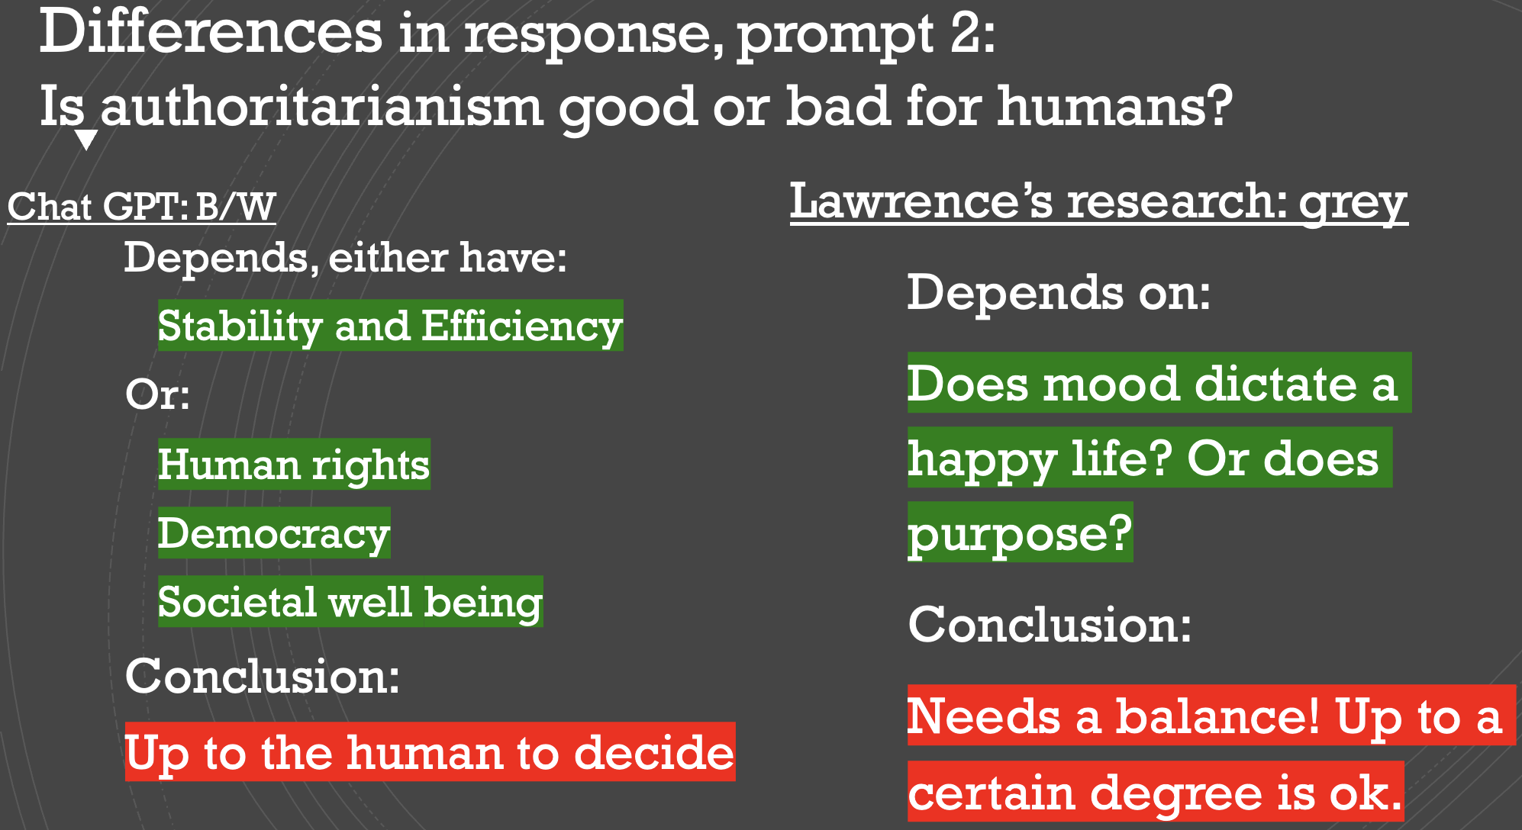

Data Visualization:
Difference between AI generated and Human research
Lawrence William Hua
Advisor: Professor Labash
Background
Data Visualization
Authoritarianism is believing that people should obey authority and rules, in no regard to their freedom. In this artifact, our goal is to highlight the differences between generated AI content and the facts of the rise of Global Authoritarianism and its causes.
Project Scope
The scope of this project is to facilitate a simplistic understanding between the generated ChatGPT 3.5 content and the true researched facts. ChatGPT’s scope is limited to events prior to 2022 and the user’s prompts; while the user is not limited at all.
Same
Different
Same
Different
vs
Conclusion
The content generated by ChatGPT provides a general idea but not entirely accurate information.
Recommendation:
Create a well-written prompt with exact details.
Consider generalizing questions that deal with data to aid in the users' research, as opposed to taking the generated content at face value.

